Slide 1
Phase Transitions For Graph Colouring
Raphael Groarke
Vrije Universiteit

Slide 2
Introduction
Peter Cheeseman wrote a paper called “Where the really hard problems are”
I am currently attempting to replicate one of the experiments covered in that paper

Slide 3

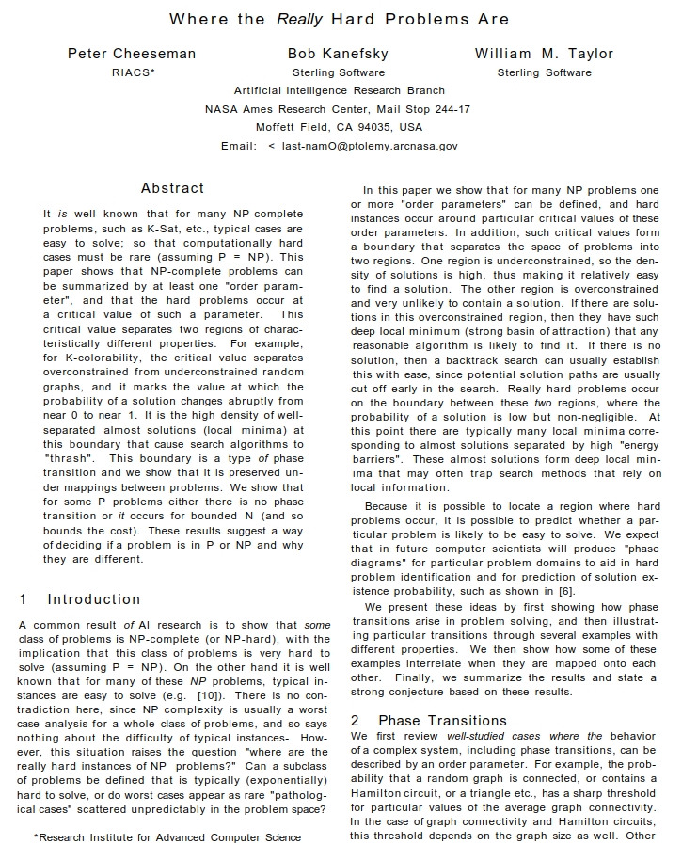
The Original Paper
There is a boundary for a type of problem where the computation cost increases dramatically
Trying to prove that phase transitions exist for a set of existing problems:
Hamilton Circuits
Graph Colouring
K-Satisfiability
Traveling Salesman
Peter Cheeseman
https://independent.academia.edu/PeterCheeseman

Slide 4

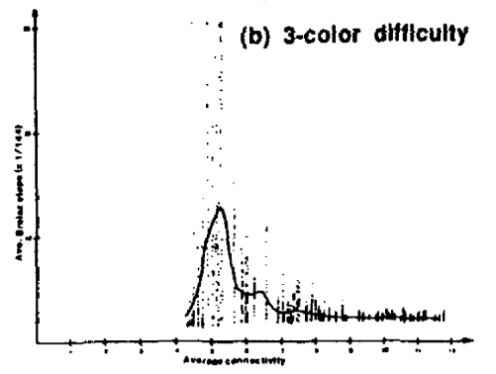
What to Expect
Better plots
Previous mistakes found about TSP
Discrepancies about the algorithm

Slide 5
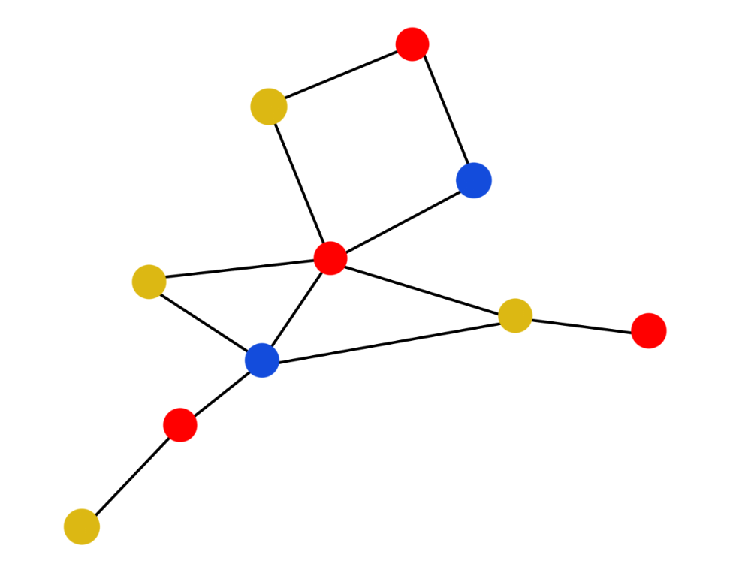
Graph Colouring
Find a minimal colouring for a graph
The constraint: No two neighbouring nodes can share a colour

Slide 6
Graph Colouring
Clique of size 3
Clique: induced fully connected subgraph

Slide 7
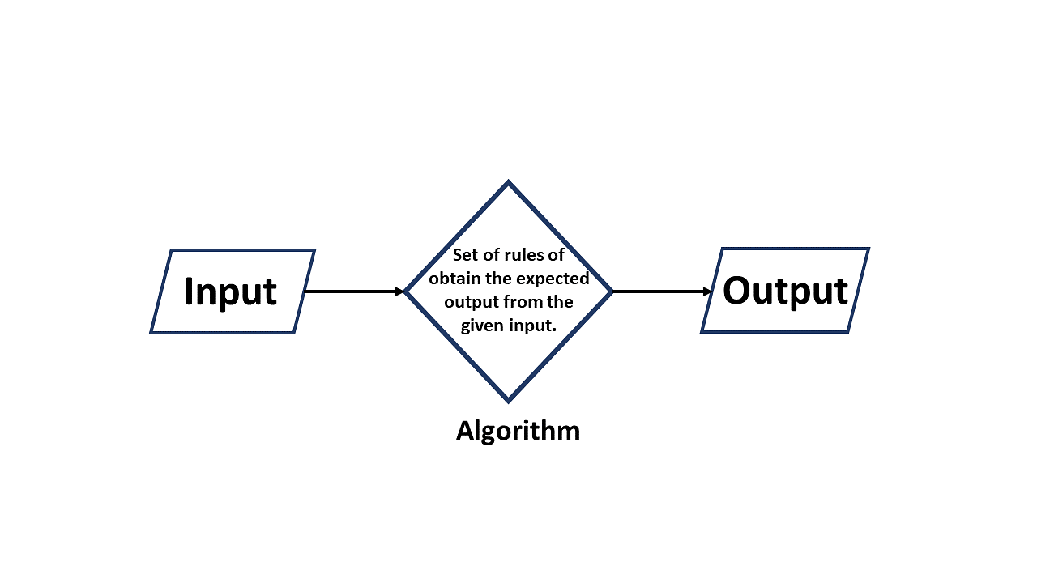
The Original Algorithm
The first algorithm mentioned is unclear
Ambiguous sources
Second algorithm which is described cannot be used
https://www.simplilearn.com/tutorials/data-structure-tutorial/what-is-an-algorithm

Slide 8

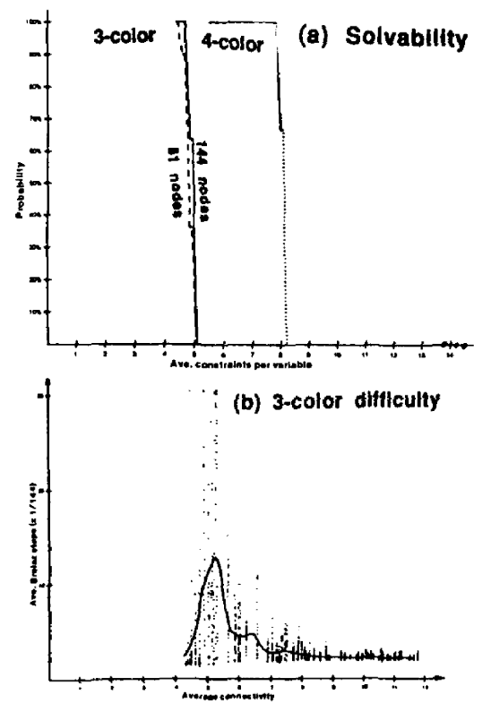
Findings From Original Paper
Horizontal axis: average connectivity per node
Original plots are only partially legible
https://www.ijcai.org/Proceedings/91-1/Papers/052.pdf

Slide 9
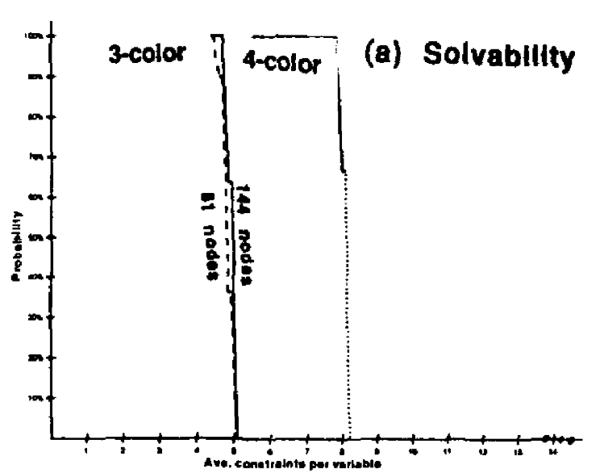
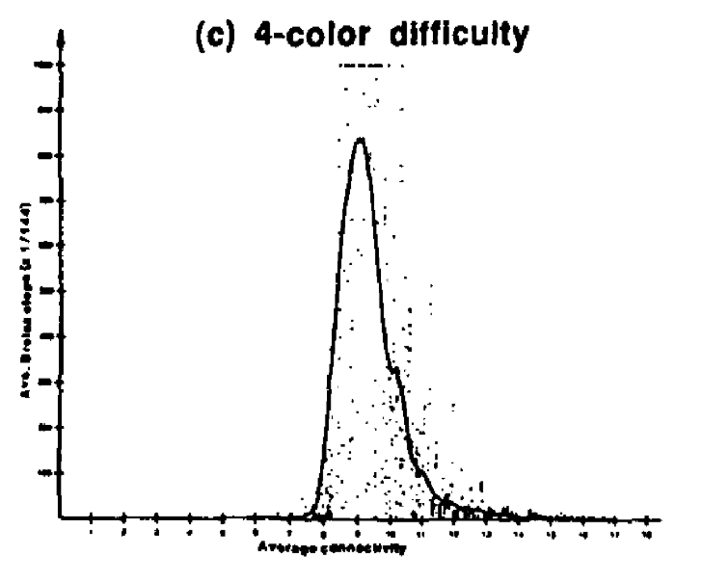
https://www.ijcai.org/Proceedings/91-1/Papers/052.pdf

Slide 10
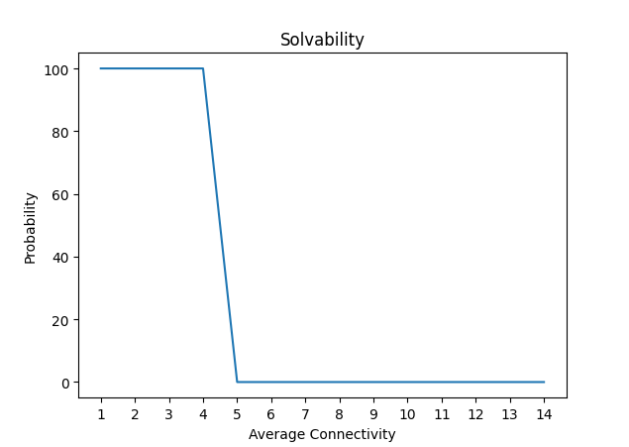
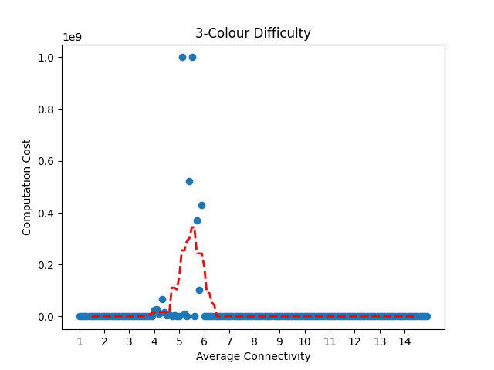
My Results

Slide 11
Future Work
Finish the plots
Look for alternate algorithms

Slide 12
Thank you!
Questions?

